Slide 2
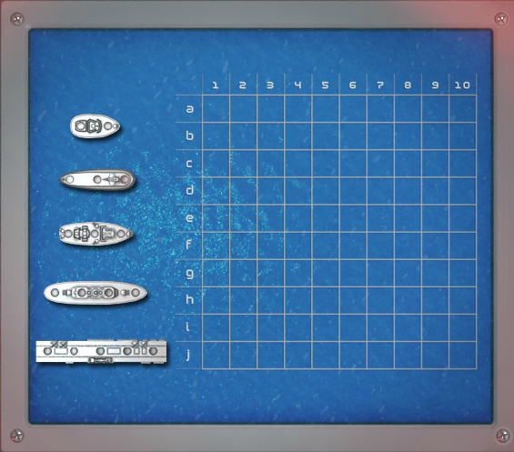

Slide 3
horizontal / x-axis

Slide 4
vertical / y-axis

Slide 5
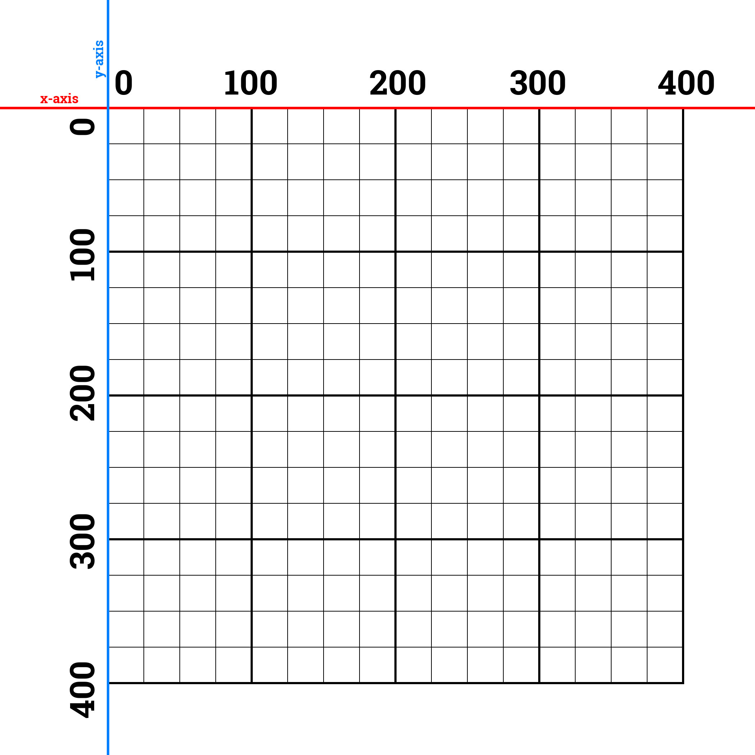

Slide 6
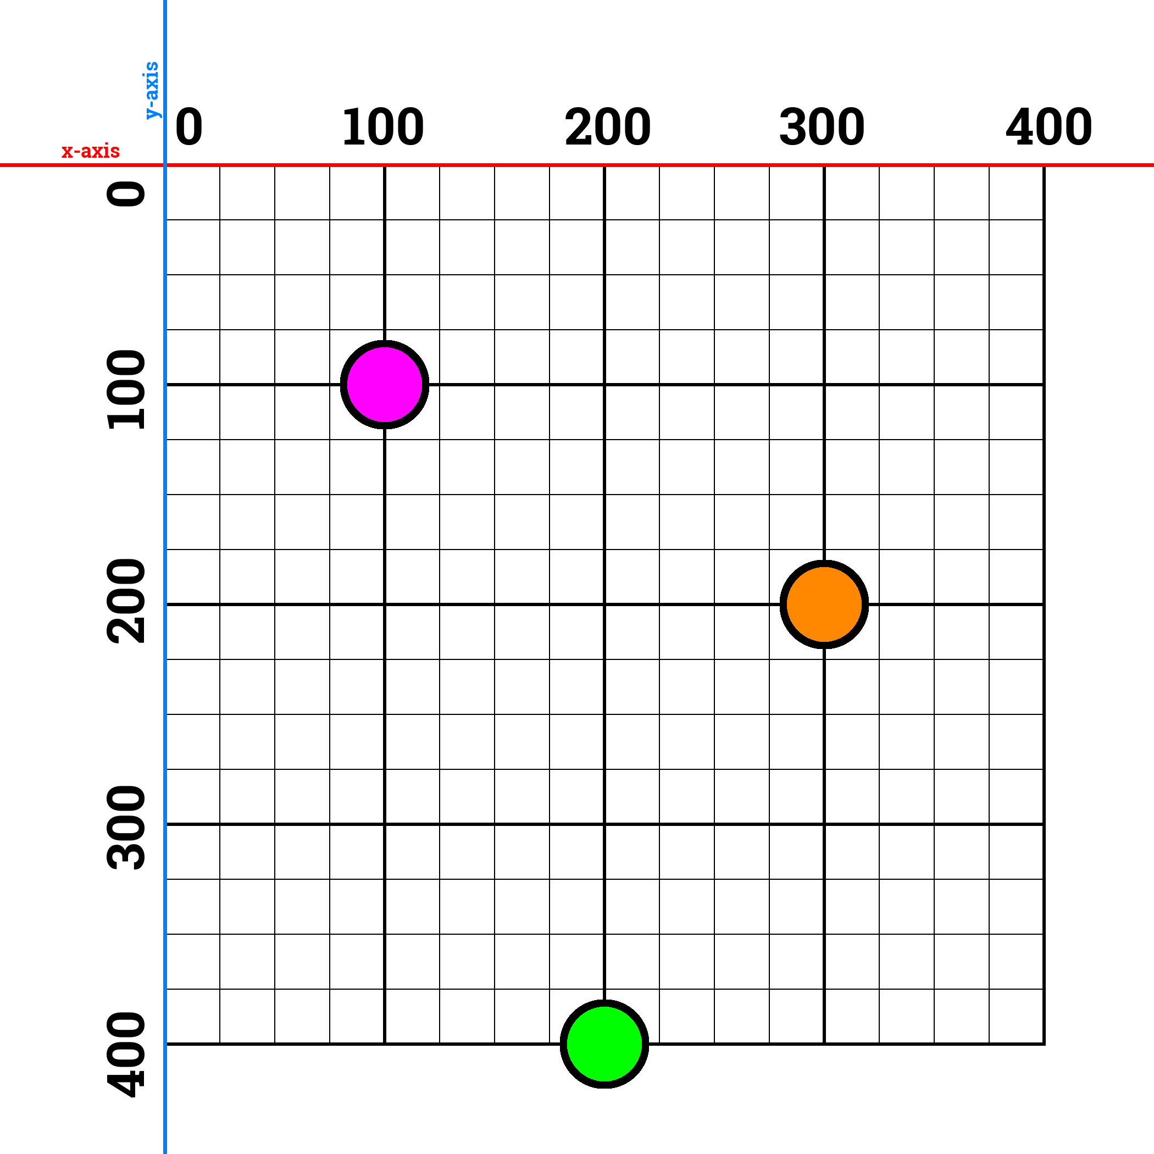

Slide 7
Making A House

Slide 8
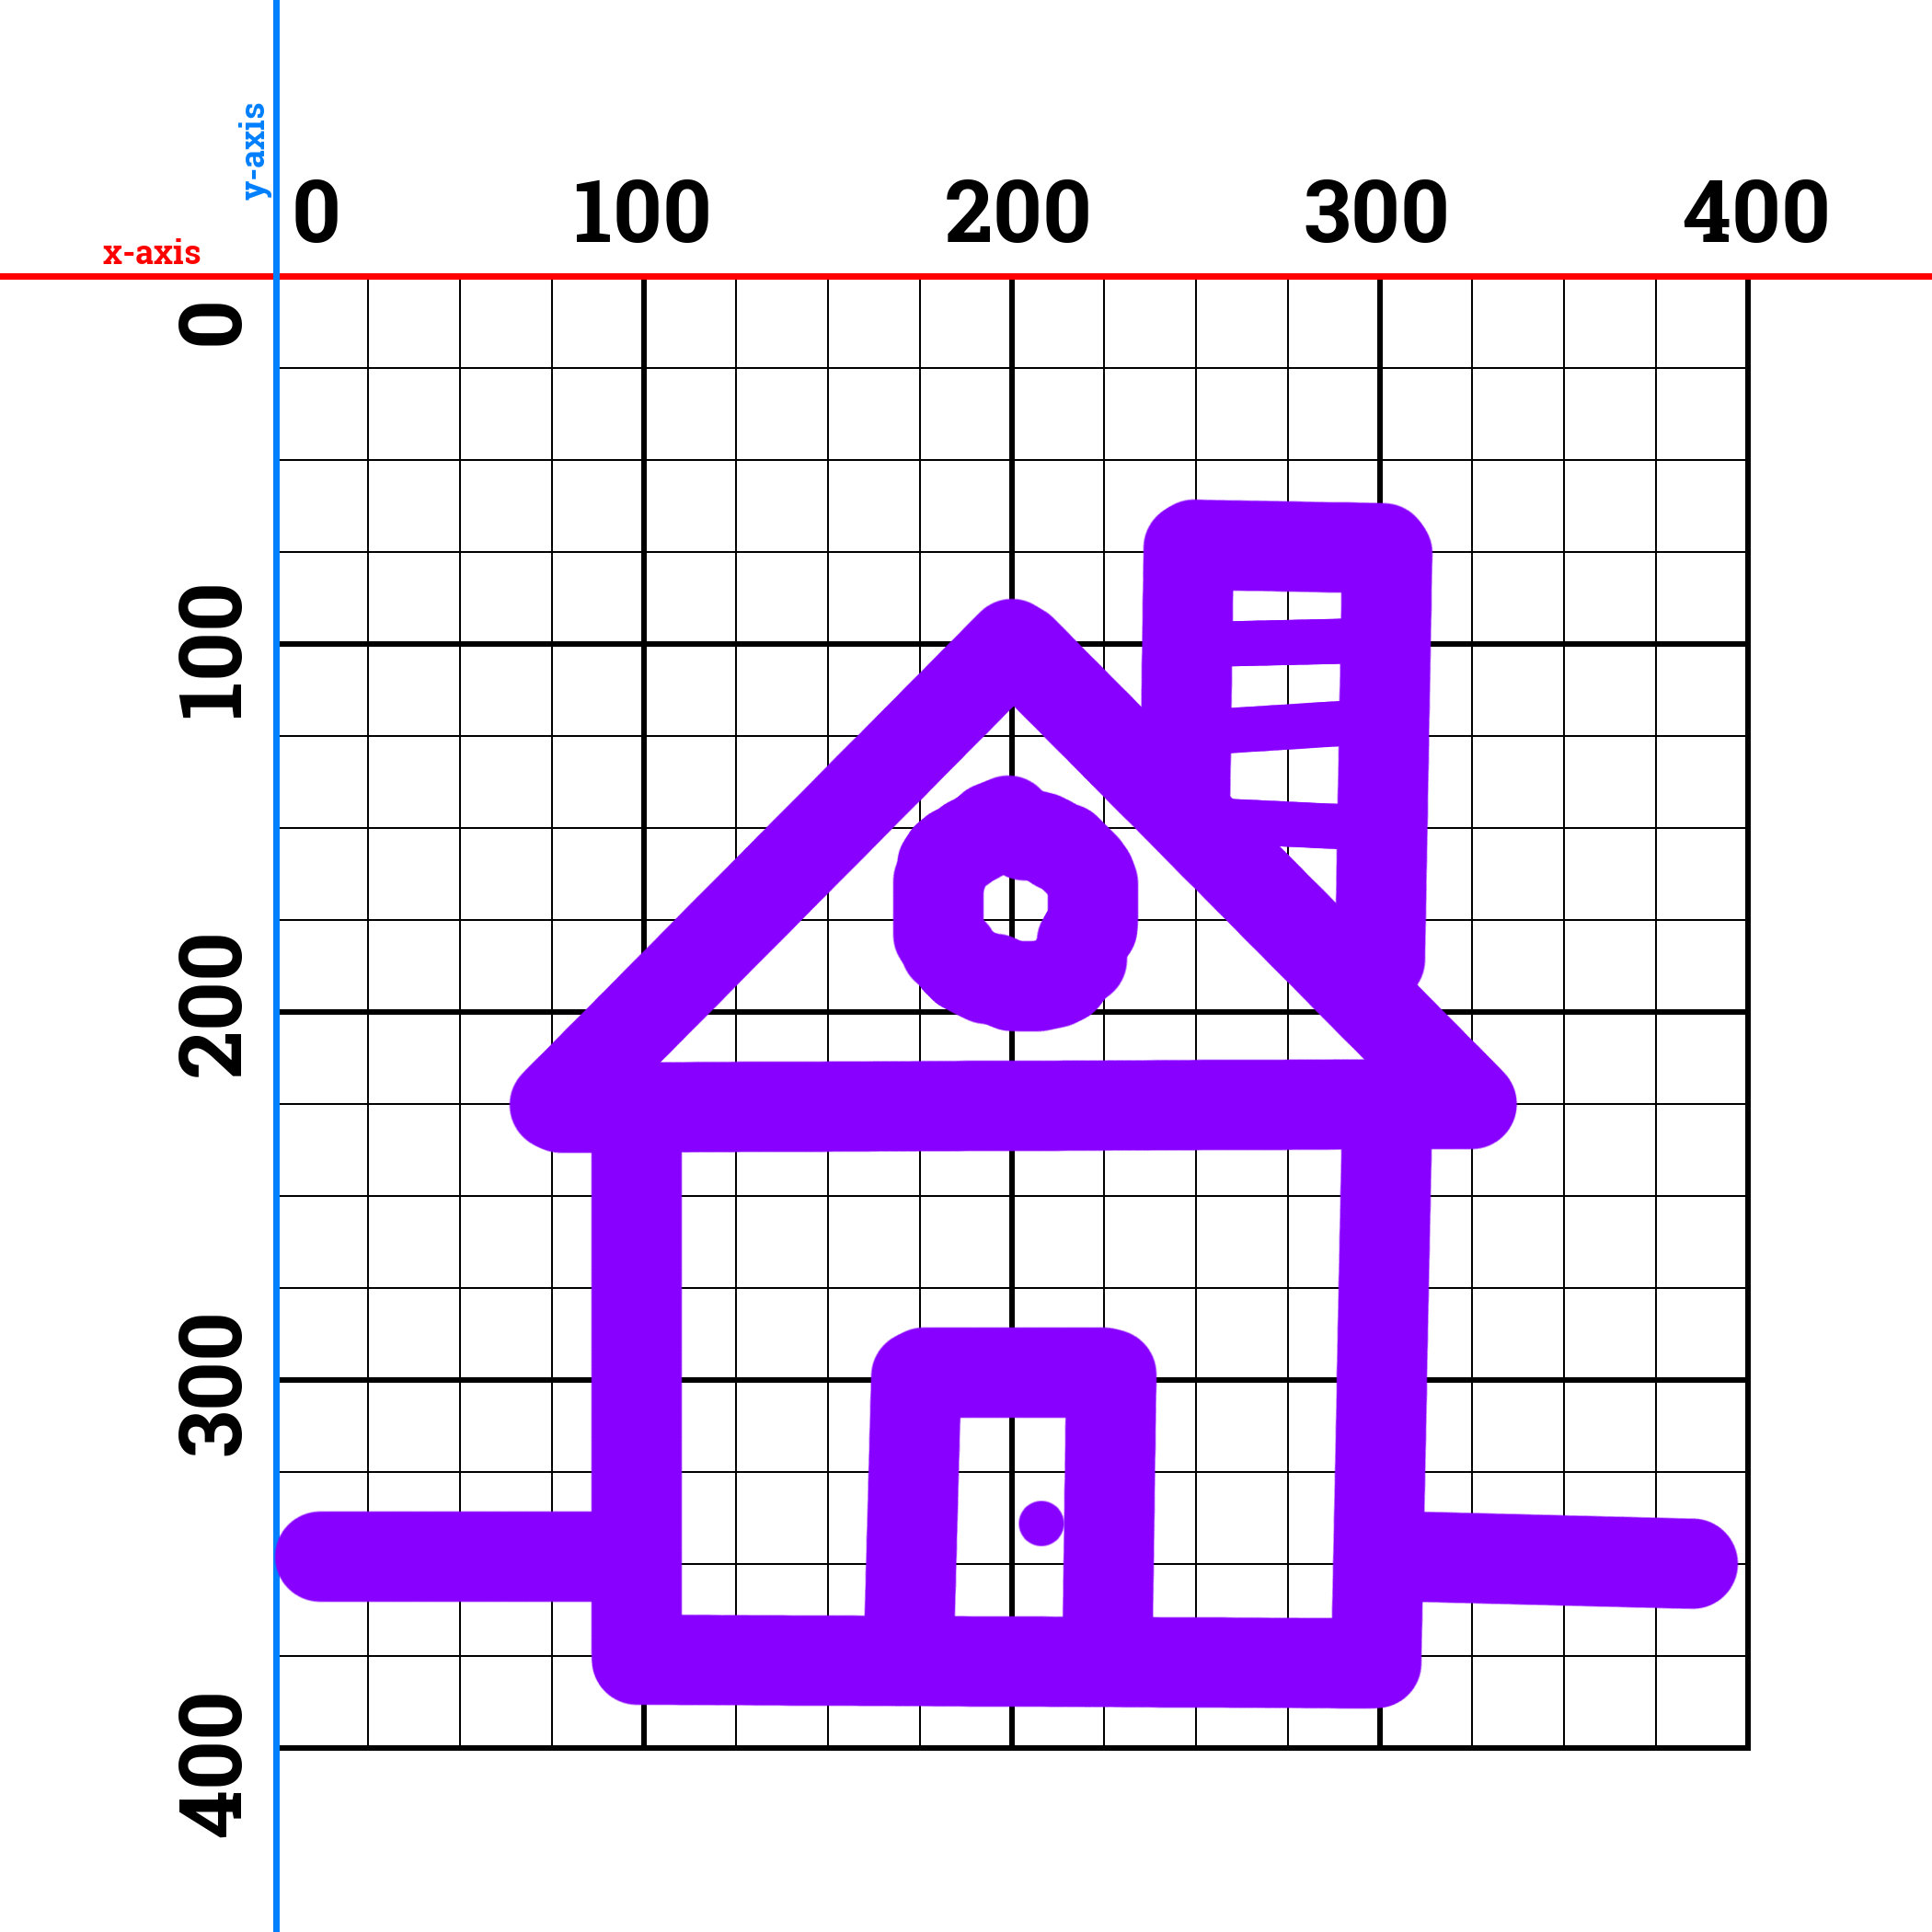

Slide 9
line
x2, y2
x1, y1

Slide 10
ellipse
x, y

Slide 11
rectangle
x, y

Slide 12
triangle
x2, y2
x1, y1
x3, y3

Slide 13
line – 100, 200, 50, 100
line(100, 200, 50, 100);

Slide 14
Shape Commands
line (x1, y1, x2, y2);
ellipse (center x, center y, width, [height]);
rect (corner x, corner y, width, height);
triangle (x1, y1, x2, y2, x3, y3);

Slide 15
Colors

Slide 16

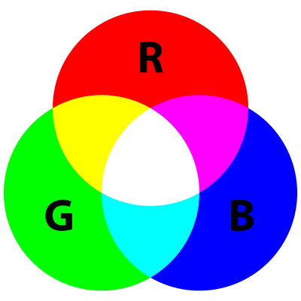

Slide 17
Red-Green-Blue
Just like coordinates are always in pairs, these go in triple.
Values go from 0 to 255. (it’s a binary thing)
If you only put one, p5.js will put that number in all three.
Use a color picker.
background(100) == background(100, 100, 100)

Slide 18
Color Commands
fill – inside color of the following shapes
stroke - line color of the following shapes
background – clear the entire screen w/ one color

Slide 20
Homework
Take your house and submit the link on Canvas.
crhallberg@gmail.com

Slide 21
Minute Surveys
Once you hand in your survey, you may go.
If you have questions or concerns, I will stay and answer them for as long as I can.

